Slide 1

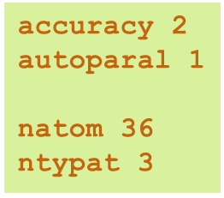
ABINIT School 2026
Learning electronic structure calculations using ABINIT
Feb. 2 - 6 2026 - Bruyères-le-Châtel, France
Tuning ABINIT
Convergence, precision, speed-up
Marc Torrent
CEA, DAM, DIF, F-91297 Arpajon cedex
Université Paris-Saclay, LMCE, F-91680 Bruyères-le-Châtel

Slide 2


Outline
DFT - Precision vs speed
Precision, accuracy, speed
What can be tuned in a plane-wave DFT code?
Automatic tuning
Speeding-up ABINIT
Basics: discretization, size
Advanced
Helping ABINIT to converge
Mixing of the density
Optimization of the wave-funtctions
Brillouin zone sampling

Slide 3
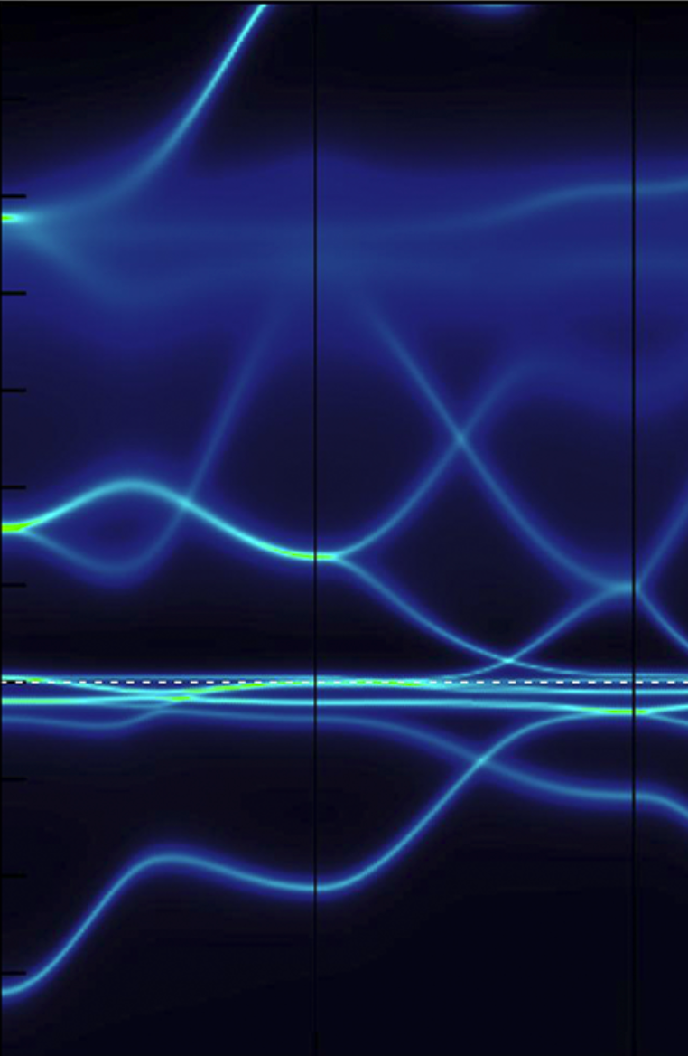
Precision vs speed

Slide 4
Precision vs speed?
Properties needing precision
Fine comparisons of energies
Derivatives of the energy: forces, stresses, phonons, pressure…
Structural relaxation (forces)
Wave-functions in view of excited states/response function
Magnetism
Etc.
Properties needing speed
Molecular Dynamics
High-throughput computing (mass calculations)
By default, ABINIT settings favor precision

Slide 5
Precision vs accuracy
By tuning the input parameters, you can increase precision…
Get more significant digits
Increase the size of the basis
Do more iterations
…
… not accuracy
Calculations (PAW) are supposed to match all-electron calculations, not experiment
Precision can be improved by: - changing the pseudopotential (change frozen-core) - adding more physics in the theory (e.g. more sophisticated exchange/correlation, exact exchange, …)
…

Slide 6
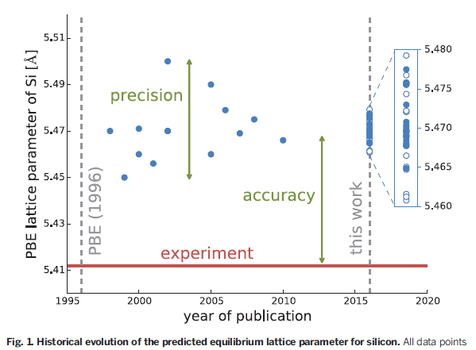
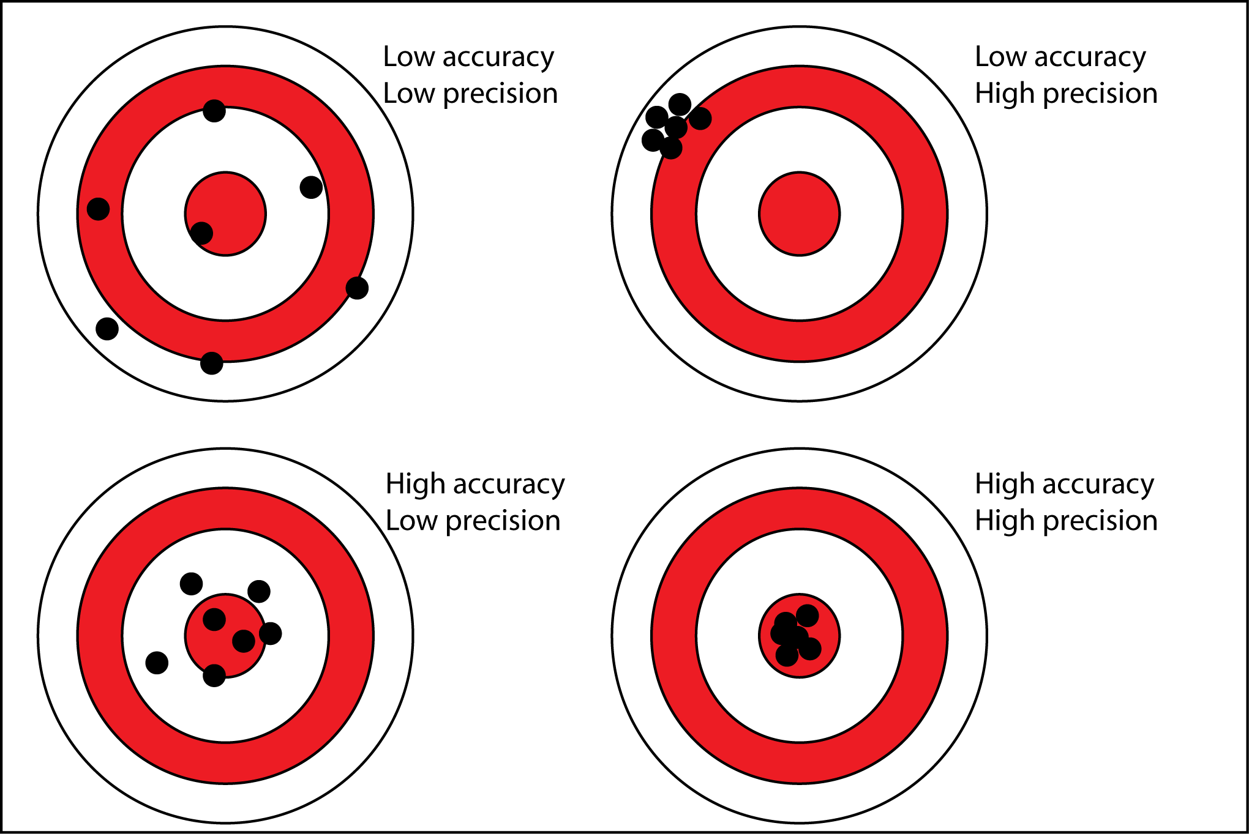
Accuracy vs precision
Lejaeghere et al., Science 351 (2016)

Slide 7

Precision in DFT codes
Discretization
Electronic density formula
Discretization of reciprocal space Number of k points Electronic occupations f_{nk}
Discretization of the real space Number of grid points (FFT grid)
Discretization in numerical schemes, in fitting procedures, etc.
Size of the plane wave basis Determined by the cut-off energy

Slide 8
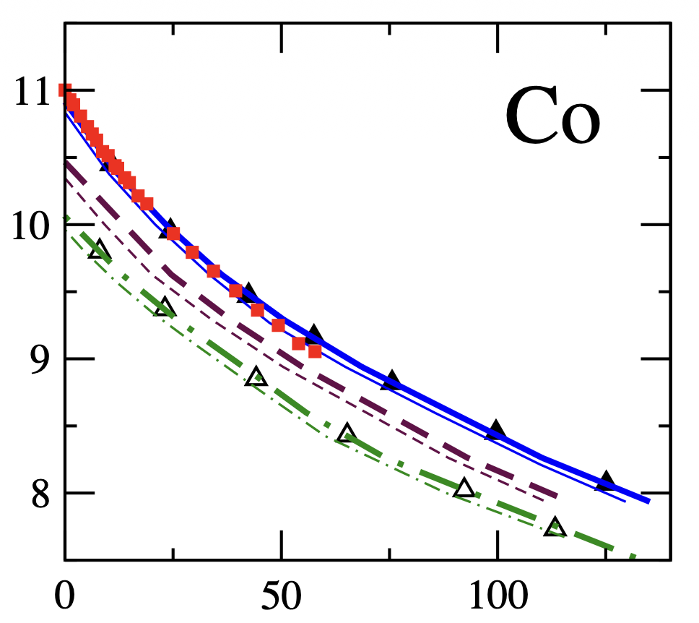
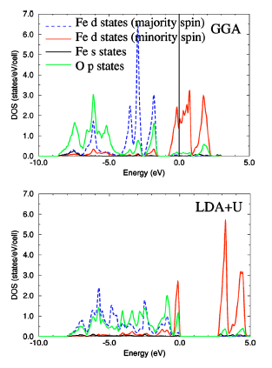
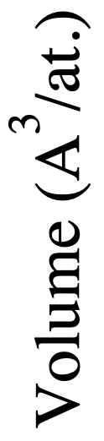
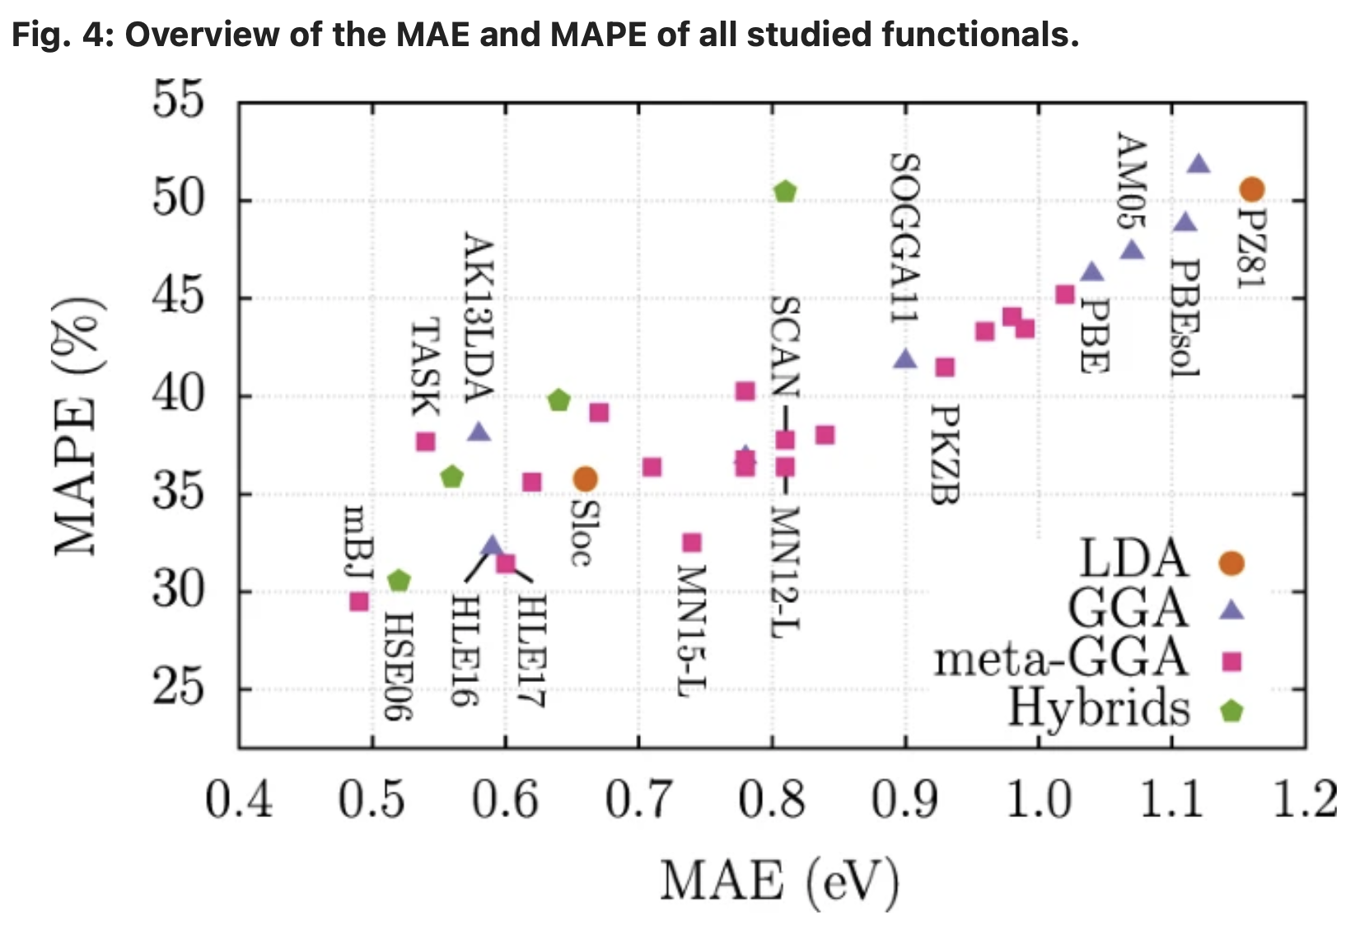
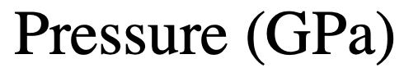
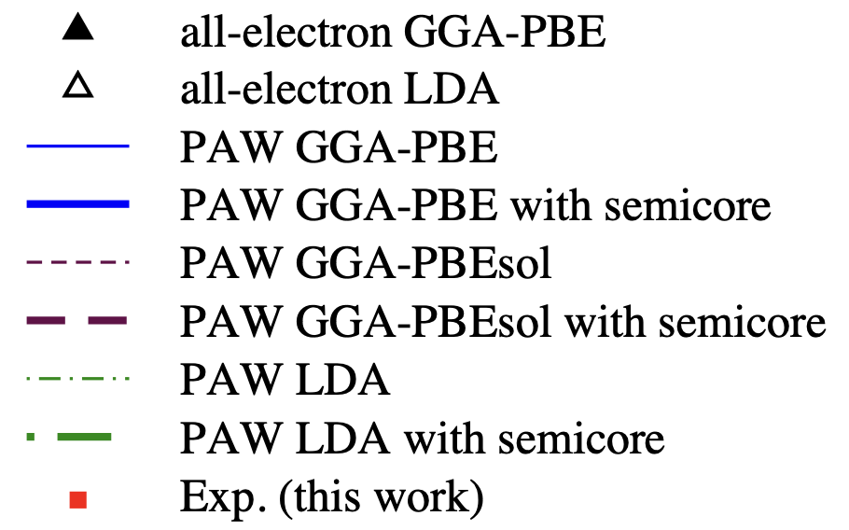
Accuracy in DFT codes
Exchange-correlation, and co …
FeO DoS
Borlido et al., npj Comput Mater 6, 96 (2020)
Cococioni, de Gironcoli, PRB 71, 035105 (2005)
Dewaele et al., PRB 78, 104102 (2008)

Slide 9
Precision in DFT codes
Convergence
Hamiltonian Local Non-local Kinetic
Eigenvalue problem
Wave functions Diagonalization in eigenvectors subspace
Energy and forces
Convergence check?
Density
Mixing of iterations Improve cycle convergence
Iterative algorithm
Wave-functions
Choice of algorithm
Number of iterations
Which wave-functions? (occupied?, s,p,d,f?)
Non self-consistent iterations if necessary
Tolerance required on energy/forces/etc.

Slide 10
Plane-wave DFT
Where do we spend time
Application of the Hamiltonian
FFT, linear Algebra
Hamiltonian Local Non-local Kinetic
Eigenvalue problem
Wave functions Diagonalization in eigenvectors subspace
Energy and forces
Convergence check?
Density
Mixing of iterations Improve cycle convergence
Time= (number of iterations) x (time spent in iterations)
Mixing scheme Preconditioning Size of history
Iterative algorithm
Number of iterations of the diagonalization algorithm
Non self-consistent iterations if necessary
Number of iterations of the self-consistent cycle

Slide 11
Precision vs speed in DFT codes
What can we tune
Improve speed, decrease precision…
Decrease the cost of the Hamiltonian application - Less plane-waves - Smaller FFTs
Decrease the sampling of the reciprocal space - Less k-points
Decrease the number of required significant digits - Increase the tolerance(s)
…or the contrary
Warning! Tolerance should always be chosen according to the property of interest

Slide 12
Precision vs speed in DFT codes
What can we tune
Improve speed… without decreasing precision
Use parallelism
Decrease the number of empty bands
Improve the efficiency of the SCF cycle - Improve efficiency of the mixing scheme - Decrease the number of iterations
Improve the efficiency of the iterative diagonalization - Fine tune the parameters of the algorithm

Slide 13
ABINIT tuning
Automatic or manual?
Automatic tuning - Pros
It’s convenient!
It’s a good starting point
Manual tuning is a challenging task
Automatic tuning - Cons
It is not optimal for all systems
Some problem can be hidden

Slide 14
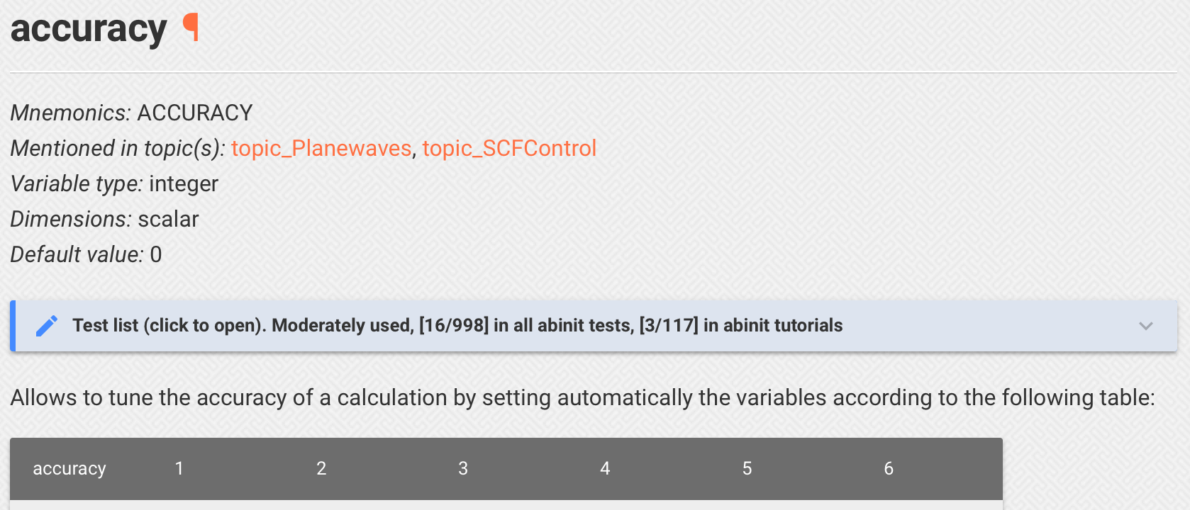
ABINIT tuning
accuracy input variable
accuracy=4 Default ABINIT behavior
accuracy = 1 : precision is low Intended for use in Molecular Dynamics
accuracy = 6 : precision is high Designed to prepare response function calculations

Slide 15

ABINIT tuning
Choice of plane-wave cut-off enrgy
Used if accuracy is activated and ecut not in input file
<?xml version="1.0"?>
-<paw_dataset version="0.7">
<atom valence=« 3.00" core="10.00" Z=« 13.00" symbol=« Al"/>
<pw_ecut high="15.00" medium="12.00" low="10.00"/>
<xc_functional name="PBE" type="GGA"/>
<generator name="atompaw-4.0.0.12" type="scalar-relativistic"/>
Can be used as ecut estimate

Slide 16
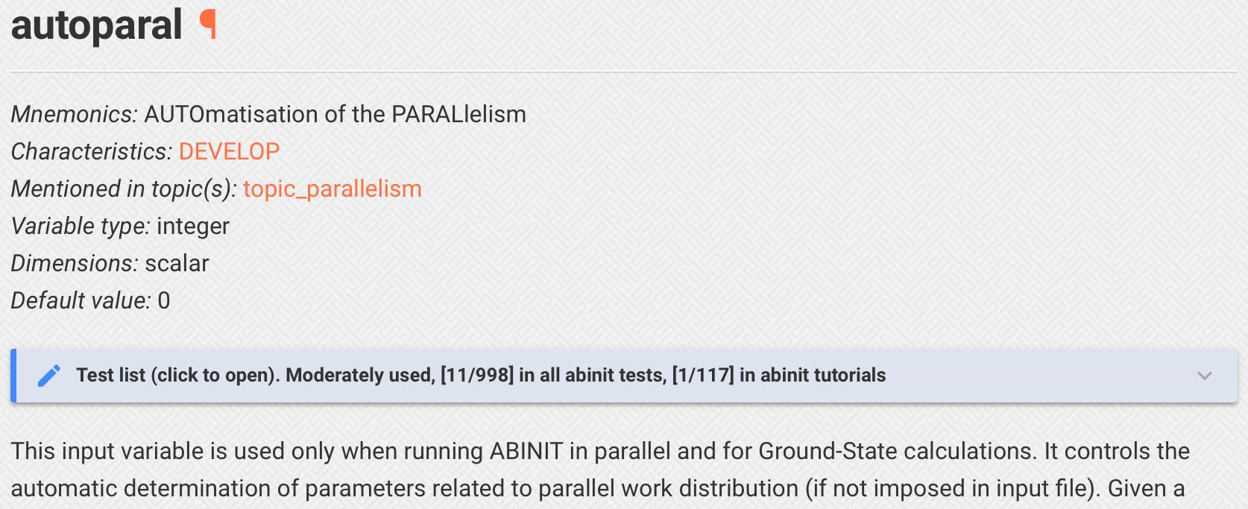
ABINIT tuning
autoparal input variable
autoparal = 1 : automatic parallelization is on ABINIT tries to determine the best distribution of processors on the different parallelization levels taking into account their respective efficient
A simple heuristics is used

Slide 17
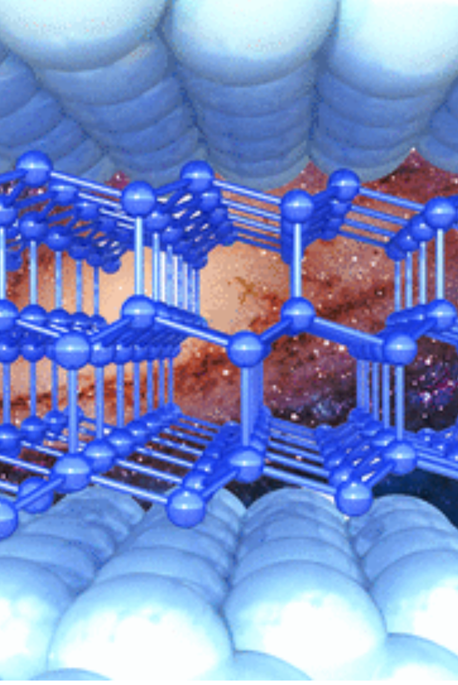
Speed-up ABINIT

Slide 18
Speeding-up ABINIT
Finding the best compromise…
… between
- the time required for one SCF iteration - the number of iterations
Increasing the precision required for one iteration usually decreases the number of iterations but takes longer per iteration!
See “Helping ABINIT to converge” section

Slide 19
Speeding-up ABINIT
Basics 1
Using parallelism See lecture on parallelism – See autoparal input variable
ABINIT takes fully advantage of the parallelism
Can be activated even on scalar computers Modern “processors” are multicore
openMP (multi-threading) is MANDATORY with ABINIT 10, when available
Deactivating useless file access
If you run only Ground-State calculations, wave-function file is not required
Molecular Dynamics can be restarted without density/wave-functions, etc.
Some files are used by specific post-processes (ex.: GSR file)
ABINIT input variables
prtwf/prtden: printing of wave-function/density (can be deactivated)
write-files ”none” : no file written
prtgsr: printing of GSR file (can be deactivated if abipy is not used)

Slide 20
Speeding-up ABINIT
Basics 2
Discretization
Decrease the plane-wave basis size
Decrease the sampling of the Brillouin zone
Decrease the size of the real space/FFT grid
Size of the system
Decrease the number of electronic states (do not compute useless empty bands)
Use a suitable pseudopotential (do not treat semi-core states when unnecessary)
ecut: PW cut-off energy
ngkpt: k-points sampling
ngfft: size of FFT grid
nband: number of bands
Warnings!
Always check convergence (don’t use rule of thumb)
Always check convergence with the studied property
Some parameters depend on the chemical specie, some on the simulation cell

Slide 21
Speeding-up ABINIT
Convergence criteria
Always confirm convergence relative to the target property!
Energy – Use tolerance on the total energy (toldfe) Cohesive energy, barrier, phase stability, etc.
Forces (1) – Use tolerance on all forces (toldff / tolrff) Molecular Dynamics
Forces (2) – Use tolerance on the maximal force precision (tolmxf) Structural relaxation
Wave-functions – Use tolerance on the WF residual (tolwfr) Preparation of excited states runs or response function runs
Other – Use tolerance on the density/potential residual (tolvrs) A generalist criterion (good compromise)
ABINIT input variables
toldfe, toldff, tolrff, tolmxf, tolwfr, tolvrs: Tolerance criteria Except for tolwfr, only one criterion can be used

Slide 22
Speeding-up ABINIT
Advanced 1
Decrease the number of SCF iterations – tuning the mixing
See “Helping ABINIT to converge” section
Adapt the density/potential mixing to the simulation cell Metal, insulator, cristal, inhomogeneous material, collinear magnetism, spin-orbit coupling, etc…
The numerical behavior of the density during the SCF cycle is highly system dependent
Number of iterations can be strongly decreased with a tuning of the mixing scheme
ABINIT input variables
diemix, diemac: parameters for density residual preconditioning
iscf, npulayit: parameters for density mixing

Slide 23
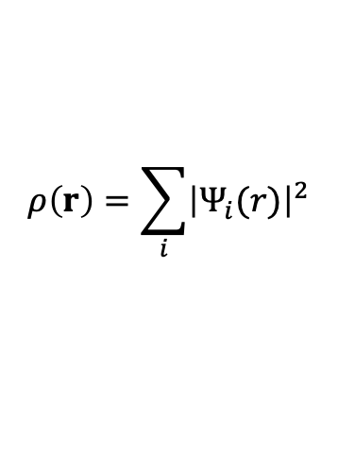
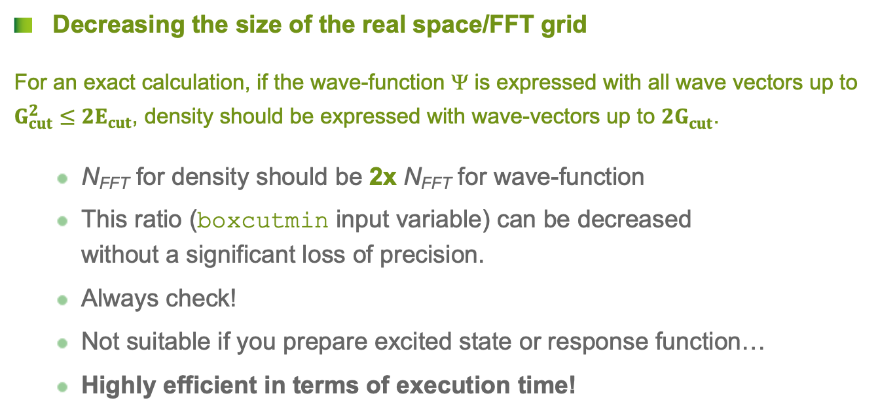
Speeding-up ABINIT
Advanced 2
$$ρ\left(r\right)=\sum_{i}{{\left|Ψ_{i}(r)\right|}^{2}}$$
Decreasing the size of the real space/FFT grid
For an exact calculation, if the wave-function Ψ is expressed with all wave vectors up to $G_{cut}^{2}≤{2E}_{cut}$, density should be expressed with wave-vectors up to ${2G}_{cut}^{}$.
N_{FFT} for density should be 2x N_{FFT} for wave-function
This ratio (boxcutmin input variable) can be decreased without a significant loss of precision.
Always check!
Not suitable if you prepare excited state or response function…
Highly efficient in terms of execution time!
ABINIT input variables
boxcutmin: ratio between wave-function and density FFT grids

Slide 24
Speeding-up ABINIT
Advanced 3
Use shifted k-points grids
There are optimal shifts for each Bravais lattice
Much more efficient and less consuming than increasing the k-point density of one grid
+
=
ABINIT input variables
shiftk, nshiftk: shifts to be applied to the k-points grid Default : one shift (½, ½, ½)

Slide 25
Helping ABINIT to converge

Slide 26
Self-consistent cycle
Hamiltonian Local Non-local Kinetic
Eigenvalue problem
Wave functions Diagonalization in eigenvectors subspace
Energy and forces
Convergence check?
Density
Mixing of iterations Improve cycle convergence
Iterative algorithm
Non self-consistent iterations if necessary

Slide 27
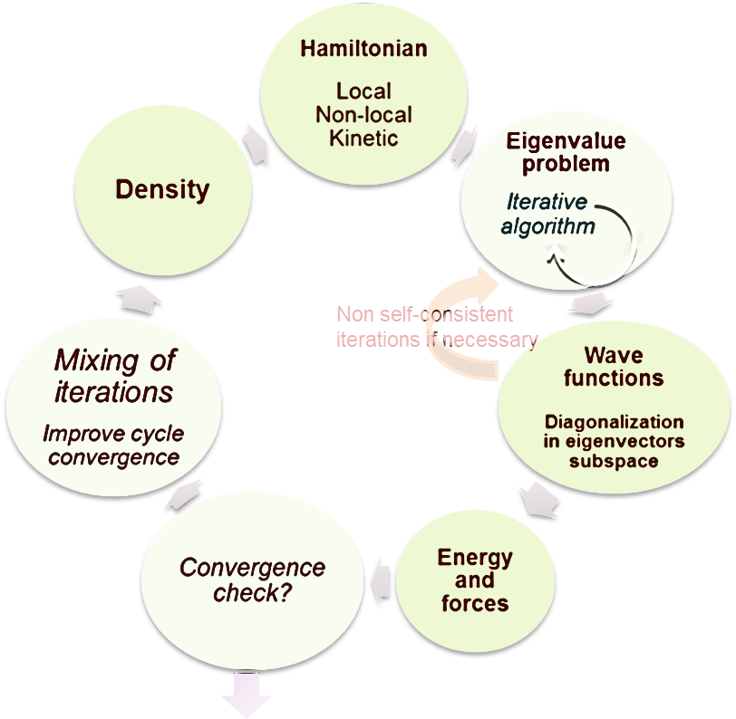
Self-consistent cycle
Mixing
Mixing the density with the densities of previous iterations
=> Damping of the oscillations
Mixing of iterations Improve cycle convergence

Slide 28
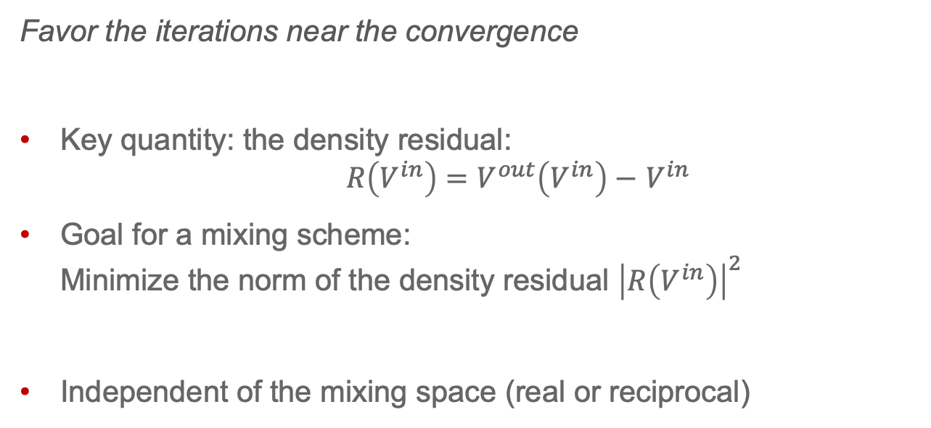
Mixing/preconditionning the density
Mixing the new iteration and previous one(s)
Favor the iterations near the convergence
Key quantity: the density residual: $R\left(V^{in}\right)=V^{out}\left(V^{in}\right)−$ $V^{in}$
Goal for a mixing scheme: Minimize the norm of the density residual ${\left|R\left(V^{in}\right)\right|}^{2}$
Independent of the mixing space (real or reciprocal)

Slide 29
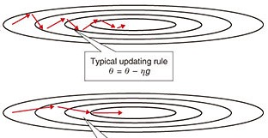
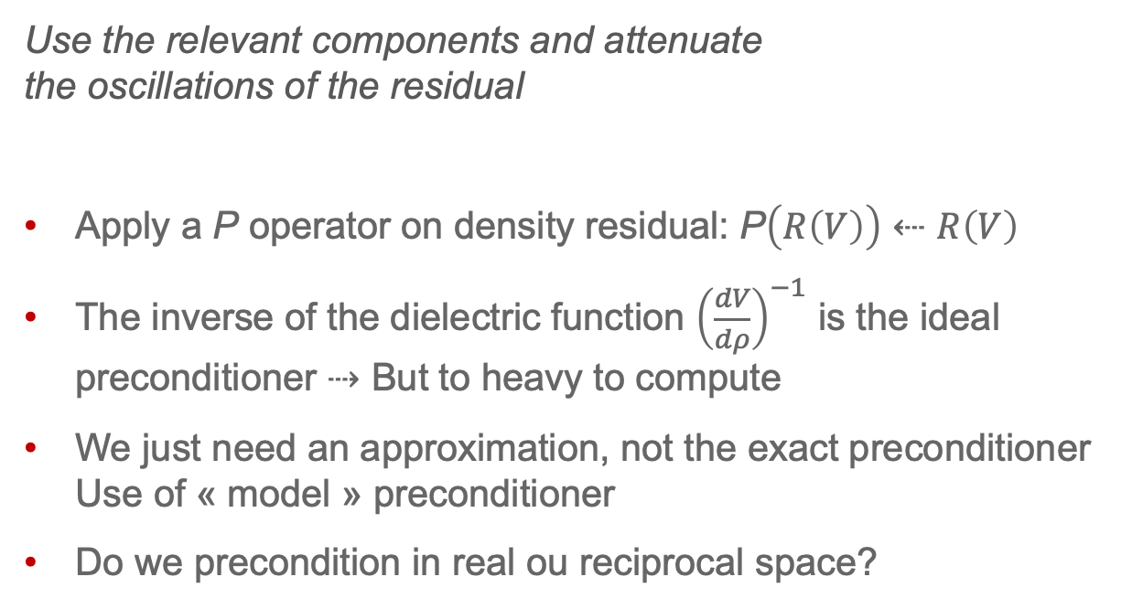
Mixing/preconditionning the density
Preconditionning the density residual
Use the relevant components and attenuate the oscillations of the residual
Apply a P operator on density residual: P$\left(R\left(V\right)\right)⇠R\left(V\right)$
The inverse of the dielectric function ${\left(\frac{dV}{dρ}\right)}^{−1}$ is the ideal preconditioner ⇢ But to heavy to compute
We just need an approximation, not the exact preconditioner Use of « model » preconditioner
Do we precondition in real ou reciprocal space?

Slide 30
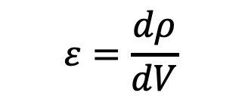
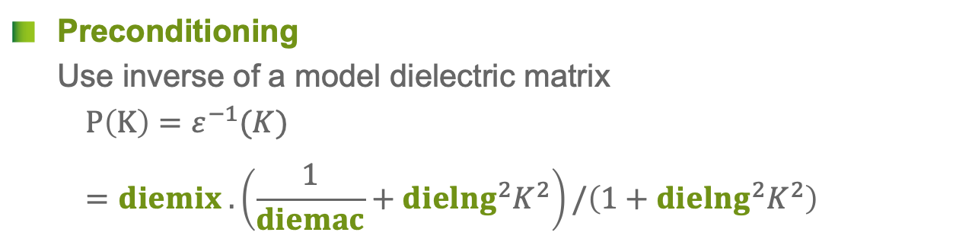
Preconditionning the density
ABINIT input variables
$$ε=\frac{dρ}{dV}$$
Preconditioning Use inverse of a model dielectric matrix $P\left(K\right)=ε^{−1}(K)=diemix .\left(\frac{1}{diemac}+{dielng}^{2}K^{2}\right)/\left(1+{dielng}^{2}K^{2}\right)$
ABINIT input variables
diemix: decrease to help convergence (but will slow it)
diemac: huge for metals, 5-10 for insulators
dielng: not really important (fine tuning)

Slide 31
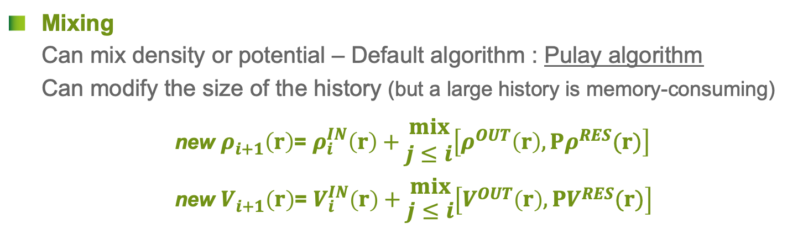
Mixing the density
ABINIT input variables
Mixing Can mix density or potential – Default algorithm : Pulay algorithm Can modify the size of the history (but a large history is memory-consuming) new $ρ_{i+1}^{}\left(r\right)$= $ρ_{i}^{IN}\left(r\right)+\begin{matrix}mix \\ j≤i\end{matrix}\left[ρ^{OUT}\left(r\right),{Pρ}^{RES}(r)\right]$ $\text{new} V_{i+1}^{}\left(r\right)\text{=} V_{i}^{IN}\left(r\right)+\begin{matrix}mix \\ j≤i\end{matrix}\left[V^{OUT}\left(r\right),{PV}^{RES}(r)\right]$
ABINIT input variables
iscf: 7 → mix the potential, 17 → mix the density Can change the behavior of the convergence
npulayit: size of history of Pulay algorithm (default=7) Increasing the size can be very efficient (→ 30)

Slide 32
Optimization of the wave-functions
Most consuming part
Eigenvalue problem
Better converge the wave-functions
=> Can reduce the Number of iterations => Each iteration takes more time
Iterative algorithm

Slide 33
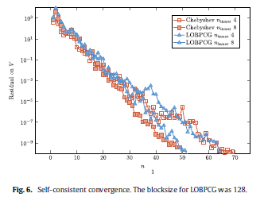
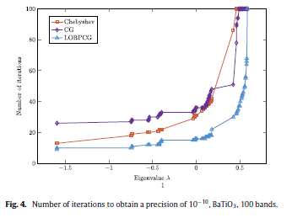
Optimization of the wave-functions
Algorithm and parameters
Convergence depends on:
System of interest
Iterative diagonalization(minimization) algorithm
Eigenvalue problem
Iterative algorithm

Slide 34
Optimization of the wave-functions
Algorithm and parameters
Choice of algorithm
Conjugate Gradient Default when no parallelization or k-points parallelization
Block conjugate gradient (LOBPCG) Default when Band-FFT parallelization
Chebyshev Filtering For a larger number of processors, for GPUs
Eigenvalue problem
Iterative algorithm
ABINIT input variables
wfoptalg: 0 → conjugate gradient 114 → block conjugate gradient 111 → Chebyshev filtering

Slide 35
Optimization of the wave-functions
Algorithm and parameters
Algorithm parameters
Required tolerance on wave-functions
Number of max. iterations
Block Conjugate Gradient: size of the blocks – One block (size N_{band}) converges better than N_{band} blocks (size 1) – But can takes longer
Eigenvalue problem
Iterative algorithm
ABINIT input variables
tolwfr: Tolerance of Wave-Function residual Decreasing it improve convergence but takes longer.
nline: number of iterations of the diagonalization algorithm Increasing it improves convergence but takes longer
nblock_lobpcg: Number of BLOCKs for LOBPCG Should be small on supercomputers

Slide 36
Optimization of the wave-functions
Non self-consistent iterations
Last chance if still no convergence…
Run the diagonalization algorithm several times, resetting it
Increase the number of Non-Self-Consistent Iterations
Eigenvalue problem
Iterative algorithm
Non self-consistent iterations
Wave functions Diagonalization in eigenvectors subspace
ABINIT input variables
nnsclo: Number of Non Self-COnsistent iterations Default: 2 iterations for steps 1 and 2, then 1 iteration

Slide 37

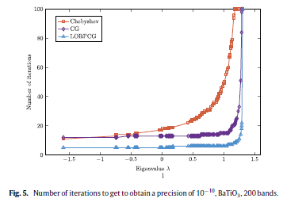


Optimization of the wave-functions
Empty bands (metals)
Empty bands do not converge as fast as occupied ones
Depends on algorithm (CG, LOBPCG…)
Last bands can really not converge
Worst case: optimize partially an electron shell
Eigenvalue problem
Iterative algorithm
s
p
d
Empty bands Many iterations to converge
Occupied bands Few iterations to converge

Slide 38
Optimization of the wave-functions
Empty bands (metals)
Solution :
Change N_{band} in order to include all the states of the last shell
Eigenvalue problem
Iterative algorithm
s
p
d
ABINIT input variables
nband: Number of BANDs to optimize Warning (metals): check that last states are really empty!

Slide 39
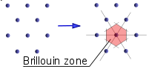
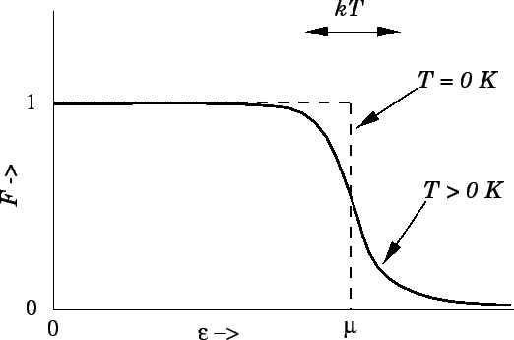
Metals / Magnetism
Sampling of Brillouin zone
Impact of sampling of Brillouin Zone:
Many properties are obtained from an integral over the Brillouin Zone
Magnetic moment is numerically sensitive
Smearing method:
In metals, integral over Brillouin Zone are discontinuous at Fermi level
Replace step function by a smoother function: → use a artificial electronic temperature
Modification of the electronic occupations

Slide 40
Metals / Magnetism
Sampling of Brillouin zone
Impact of sampling of Brillouin Zone:
Many properties are obtained from an integral over the Brillouin Zone
Magnetic moment is numerically sensitive
Solution:
Find the right balance between smearing and sampling density
ABINIT input variables
nkpt/ngkpt/etc.: number of k-points
occopt: smearing scheme for occupations (3<=occopt<=7)
tsmear: smearing temperature

Slide 41
Conclusion
Tuning ABINIT – Key points
ABINIT default settings favor precision
To run ABINIT faster, you can use the automatic method or the manual one
To help ABINIT to converge it is necessary to have a minimal knowledge of the internal algorithms
Convergence cycles
Mixing algorithms
Discretization

Slide 42



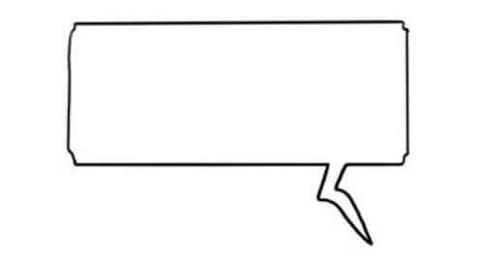

In the 21st century they used ABINIT in the PAW approach!
Facinating!

